Slide 1
Modernizing Applications with Containers and Orchestrators

Slide 2
Module 2 – Getting Started with Windows Containers
Notes:
How they are different from Linux containers?
What workload this support enable?

Slide 4
Objectives
Introduce Windows Containers
Understand the Microsoft and Docker Partnership
Explore Windows Container Images
Work with Dockerfiles
Build and run a variety of Windows containers
Learn about Visual Studio Support for Docker
Understand how to perform container updates
Notes:
2 types of Windows Containers isolation: native and hyper-v
2 different base images: nanoserver and windows container.
Differences between Linux and Windows containers
What scenario Windows Containers enable (SQL Server, IIS hosted, ASP.NET full framework, …)
VS support for Docker
Active Directory Service Account for Win Containers
Patch and upgrade containers

Slide 5
Application innovation with Windows containers
Windows Server 2019
Windows Server, version 1803
Optimized Server Core image
App compat improvements
Enhanced Group Managed Service Account support
Platform functionality for Kubernetes and Microsoft Service Fabric
Performance and density improvements
Platform and open-source work on CNI networking plugins such as Calico and Flannel
Enhancements to the Windows Subsystem for Linux
…you will have to wait
Optimized Server Core image
App compat improvements
Native command line tools—curl.exe, tar.exe and SSH
Enhancements to the Windows Subsystem for Linux
Networking enhancements for greater density and quicker endpoint creation
Improved network security with Calico Open-source storage plugins for Kubernetes
Platform functionality required for Kubernetes conformance
Windows Server, version 1709
Windows Server 2016
Optimized container images for Nano Server and Server Core
Platform level support for Linux containers
Windows Subsystem for Linux
Networking enhancements for overlays and SDN
Initial launch of containers
Process and Hyper-V isolation
Docker EE Basic Included at no additional cost
Notes:
Docker runs on any Linux system with a Linux kernel of 3.10 or later. That kernel version appeared in 2011, so most Linux distributions released since then work with Docker
In the Windows world, Docker only with Windows 10 desktop systems and Windows Server 2016 and 2019
While Windows containers are newer in the container’s space, they are evolving rapidly and getting closer and closer to parity with Linux containers
Things to keep in mind when transitioning to the container's world:
Windows admins are typically more accustomed to being able to administer their systems and applications graphically, but containers are much more command line driven
How did Microsoft drive some of this innovation? We partnered with Docker

Slide 6
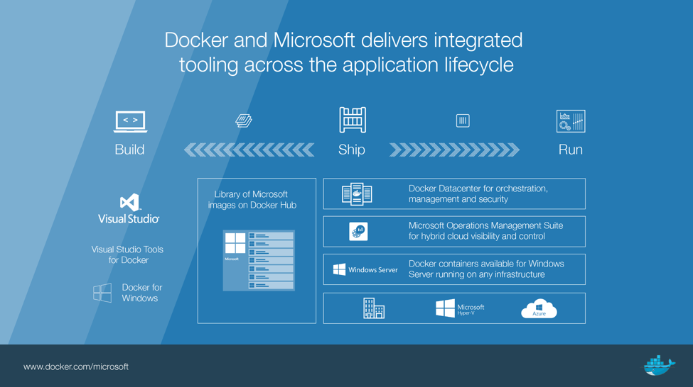
Notes:
Docker was originally developed on Linux, taking advantage of core Linux Features, but making it simple and efficient to use containers for application workloads.
Microsoft saw the potential and worked closely with the Docker engineering team to bring the same functionality to Windows
You can have Docker support in Microsoft Cloud and on premises.
MS built the windows-based images to allow Windows dev to work with Docker
Development of Windows containers (translation between Docker engine and OS.)
MS for OS expertise
Docker for Docker engine expertise (more in next module)
No Licensing cost for Windows base images
As long as License is paid for the host

Slide 7
Docker and Microsoft Partnership
Docker Engine is tested, validated, and supported on Windows Server 2016 and 2019/Windows 10 customers at no additional cost
Microsoft will provide Windows Server 2016 and 2019 customers enterprise support for CS Docker Engine, backed by Docker, Inc.
Integration between Visual Studio Tools for Docker and Docker for Windows
Windows Server container base images discoverable on Docker Hub
Notes:
Docker is supported throughout Microsoft Cloud and on-premises ecosystem
Integration between Visual Studio Tools for Docker and Docker for Windows provides complete desktop development environments for building Dockerized Windows apps
Note: CS Docker Engine stands for Commercially Supported: https://docs.docker.com/v17.12/cs-engine/1.13/

Slide 8
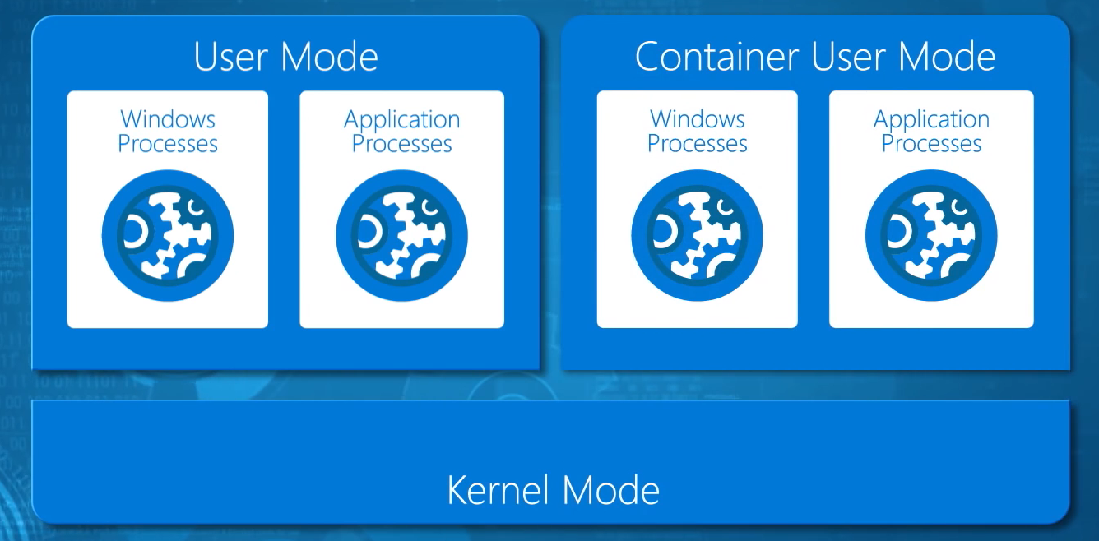
Windows Containers Shared Kernel Model
Notes:
When you enable Containers on WS2016/2019 in the kernel allows multiple user modes.
This gives us isolation:
Namespace isolation: Each container sees it’s own file system and registry (the hives in the containers hosted files)
Resource isolation: How much process, memory, and CPU a container can use
Need a Kernel Level Feature? Not a good candidate for containerization
When you start a user-mode application, Windows creates a process for the application. The process provides the application with a private virtual address space and a private handle table. Because an application's virtual address space is private, one application cannot alter data that belongs to another application.
All code that runs in kernel mode shares a single virtual address space. This means that a kernel-mode driver is not isolated from other drivers and the operating system itself. If a kernel-mode driver accidentally writes to the wrong virtual address, data that belongs to the operating system or another driver could be compromised. If a kernel-mode driver crashes, the entire operating system crashes.

Slide 9
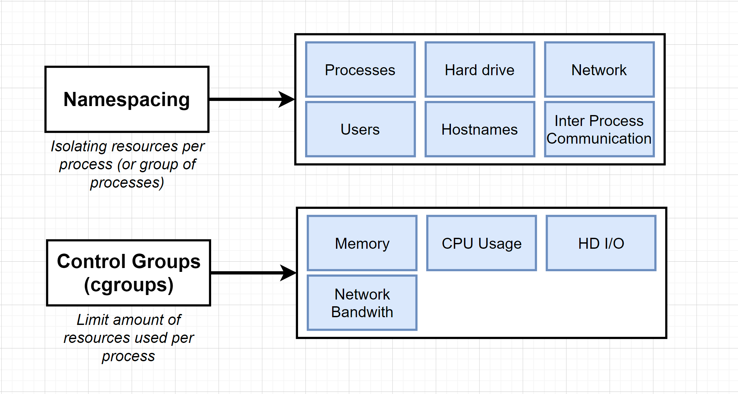

Slide 10
Windows Containers
Namespace and Resource Isolation
Container sees it’s own file system and registry and can be told how much process, memory, and CPU it can use.
Network virtualization
Each application/container could have it’s own IP address to provide a layer of isolation so that the container doesn’t have access outside of its sandboxed execution environment
OS
Windows Server
Container
Windows Server
Container
App A
App B
Bins/Libs
Bins/Libs
Docker Engine
Windows Server vNext Kernel
Server Hardware
Notes:
The containers use advanced isolation techniques to provide discreet and portable environments that include most everything an application needs to be fully functional.
One of the modern features of operating systems that makes containers particularly robust and secure is the idea of sandboxing.
Sandboxing is the idea that each program running on a computer should do so independently of any other program.
It should have its own memory, its own identity when accessing files, and it should have its own place on the machine to store things (like preferences and user information).
Each program is isolated from the other programs. Because of sandboxing, each container can be trusted: it will not share anything with any other container — and therefore can be treated like a completely independent machine
Architecture close to previous module:
OS => Windows Server 2019
Docker engine
Multiple containers on top of it
Same concepts in Physical Isolation… but virtualized

Slide 11
Types of Windows Containers
Windows Server containers: maximum speed and density
Hyper-V containers: isolation plus performance
OS
Container
Container
Container
Applications
Container
Container
Container
Kernel
Kernel
Kernel
Kernel
Hardware
Hyper-V
Namespace, resource control and process isolation
Shared host kernel
Run inside a light-weight, utility VM
Kernel-level isolation
Isolation level can be specified at runtime --isolation=process or hyperv
Notes:
On Windows, you have two ways of running containers.
Run containers directly on the host, using Windows Server Containers.
Using specialized Hyper-V instances (Utility VMs) to host your containers
On Linux, there is no official equivalent of Hyper-V mode for containers. You could set up a virtual server instance yourself to host your containers, which would more or less give you the same type of architecture as Hyper-V mode on Windows. But this approach is not built into Docker for Linux in the same way that it is for Windows containers.
Containers are managed by the Hyper-V hypervisor deployed on the host
The Windows Host Compute Service (HCS) is a low-level container management API in Hyper-V, by running the hcs diag command, you can see the lightweight utility VMs
Native/hyper-V containers can run side by side
Switch from hyper-V to native
Container that can run on a Windows Server container can run on Hyper-V container
Q: I thought that containers do not need a hypervisor?
A: Correct, but since a Hyper-V container packages the same container image with its own dedicated kernel it ensures tighter isolation in multi-tenant environments which may be a business or application requirement for specific Windows Server 2016 applications.
Q: Can the Hyper-V containers be managed from the Hyper-V Manager, in the same way that the VM’s are? (ie. turned on/off, check memory usage, etc?)
A: While Hyper-V is the runtime technology powering Hyper-V Isolation, Hyper-V containers are not VMs and neither appear as a Hyper-V resource nor be managed with classic Hyper-V tools, like Hyper-V Manager. Hyper-V containers are only executed at runtime by the Docker Engine.

Slide 12
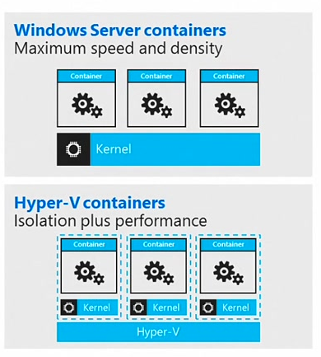
How Hyper-V Containers are Different?
Windows Server Container applications that are pushed or pulled from the Docker Hub or local repository can be placed in either a regular Windows Server Container or a Hyper-V Container without any modification.
Hyper-V Containers offer both OS virtualization (container) and machine virtualization (VM) in a slightly lighter-weight configuration than a traditional VM.
Notes:
Alternatively => Hyper-V containers
Hyper-V containers run inside a lightweight hyper-v environment. The OS Kernel is injected into the environment and NOT shared with the host.
PROS
1. Greater isolation of processes running inside the container
2. The Container OS version can be older than the Host OS Version (kernel is not shared) https://docs.microsoft.com/en-us/virtualization/windowscontainers/deploy-containers/version-compatibility
CONS:
1. startup time is slightly slower than Windows Containers due to the hyper-v overhead
2. uses slightly more resources (memory and cpu)
3. Next Slide (LCOW)

Slide 13
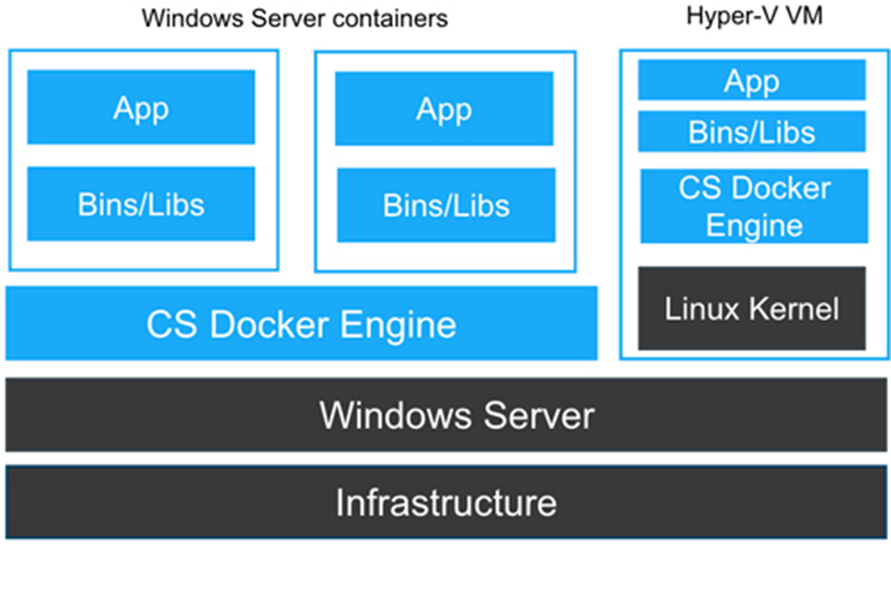
Hyper V Containers with Linux
Notes:
You can also run linux containers as Hyper-V containers by having Windows inject the Linux kernel instead of the windows kernel
https://blog.docker.com/2016/10/considerations-running-docker-windows-server-2016-hyper-v-vms/

Slide 14
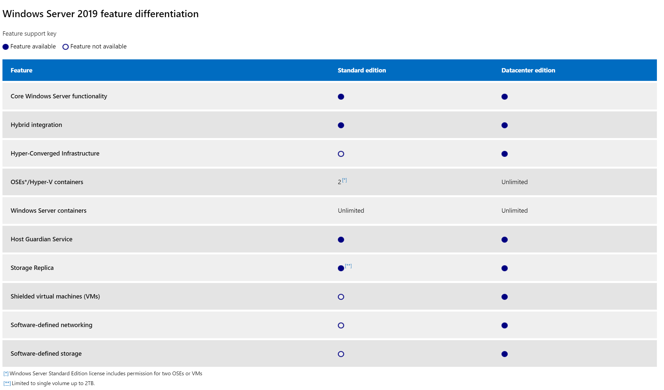
Windows Server 2019 Editions
Notes:
Step back to the HOST: 2 Editions of Windows Server 2019 => Standard & Datacenter
Both support the core server and container capabilities
Limitation with Standard:
2 Hyper-V containers (same at 2016)
Note 1: Windows Server 2019 generally announced.
Side by side Linux & Windows containers
Smaller image size 70% faster to download.
Note 2: Shielded VM definition: advanced security to prevent VM from being copied by people having access to them. (to prevent them from copying secret files or things like that)
Note 3: shielded VM: https://blogs.technet.microsoft.com/windowsserver/2016/05/10/a-closer-look-at-shielded-vms-in-windows-server-2016/

Slide 15
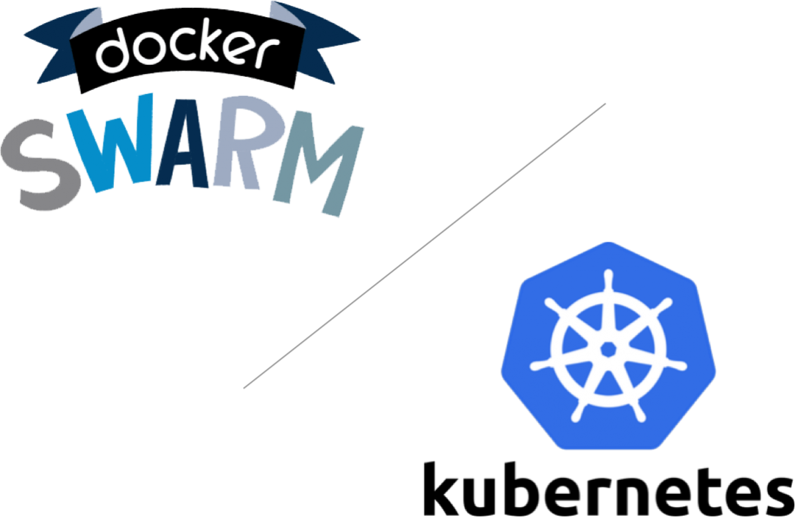
Docker Desktop for Windows
By installing “Docker Desktop for Windows”, Docker developers can use a single Docker CLI to build apps for both Windows or Linux
Includes everything you need to build, test and ship containerized applications right from your machine
Integrated tools including the Docker command line, Docker Compose and kubectl command line
Docker Desktop allows you to develop applications locally with either Docker Swarm or Kubernetes
Notes:
Docker is a full development platform for creating containerized apps, and Docker Desktop for Windows is the best way to get started with Docker on Windows.
Simple, integrated Docker development environment for Windows 10
Installs Hyper-V Moby Linux VM – can run Linux containers on Windows
Download: https://hub.docker.com/editions/community/docker-ce-desktop-windows
Docker Desktop works with your choice of development tools and languages and gives you access to a vast library of certified and community containerized content in Docker Hub.
Whether you're developing Windows or Linux apps; legacy apps or new cloud native applications, with Docker Desktop you're in control
Choice of Docker Swarm or certified, unforked Kubernetes distribution
One-click setup of Kubernetes, providing the easiest way to get up and running on Docker with Kubernetes
Certified Kubernetes distribution that is proven to be conformant and recertified every year
Note: Interactive terminals do not work in PowerShell ISE (but they do in PowerShell).
Docker Desktop provides the Docker Engine with Swarm and Kubernetes orchestrators right on the desktop, all from a single install
https://blog.docker.com/2018/12/introducing-desktop-enterprise/
While the Docker CLI meets the needs of managing one container on one host, it falls short when it comes to managing multiple containers deployed on multiple hosts targeting more complex distributed applications. In most cases, you need a management platform that will automatically spin containers up, suspend them or shut them down when needed and, ideally, also control how they access resources like the network and data storage. To go beyond the management of individual containers or very simple composed apps and target larger enterprise applications and microservices approaches, you must turn to orchestration and Figure 5-6. Cluster of containers 21 Architecting and developing Docker applications clustering platforms for Docker containers

Slide 16
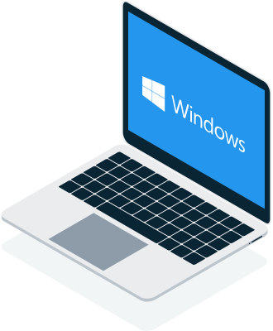

Windows 10 vs. Windows Server
Docker Desktop for Windows
Docker on Windows Server
Notes:
Remember “Docker Desktop” is meant for development purposes and hence its only recommended to install it on your Windows 10 machine.
Windows Server 2016 and 2019 install Docker Enterprise Edition(EE) as a feature

Slide 17
Docker on Linux Vs Windows Server
Docker Swarm
Docker Compose
Docker Swarm
Docker Compose
Docker Registry
Docker Client
Docker Registry
Docker Client
REST Interface
REST Interface
Docker Engine
Docker Engine
graph
libcontainerd
graph
libcontainerd
libnetwork
libnetwork
plugins
plugins
containerd + runc
Operating System
Operating System
Compute Service
Other OS functionality
Control Groups
cgroups
Namespaces
Pid, net, ipc, mnt, uts
Layer Capabilities
Union Filesystems AUFS, btrfs, vfs, zfs*, DeviceMapper
Other OS functionality
Control Groups
Job Objects
Namespaces
Object Namespace, Process Table, Networking
Layer Capabilities
Registry, Union like filesystem extensions
Notes:
Initial Slide: LINUX
Click: WINDOWS
With all these pieces in place, containers running on Windows Servers are a reasonable parallel to their Linux cousins: a sandboxed environment with a subset of the Windows services that runs atop a shared kernel.
And with a Windows-native Docker Engine available, developers can now use the same Docker command line interface and APIs as with the Linux version of the platform.
Building a great management API for Docker was important for Windows Server Containers.
There’s a ton of really cool low-level technical work that went into enabling containers on Windows, and we needed to make sure they were easy to use.
The HCS was a stable API Docker could build upon, and it was also easier to use.
Making a Windows Server Container with the HCS is just a single API call.
Making a Hyper-V Container instead just means adding a flag when calling into the API.

Slide 18
Windows Server Containers
Host User Mode
System Processes
Session Manager
Local Security Authority
Container Management
Windows Server Container
Windows Server Container
Event Manager
Docker Engine
Etc…
Compute Services
System Processes
Application Processes
System Processes
Application Processes
Job Output
Net Interface
Storage
Registry
Job Output
Net Interface
Storage
Registry
Windows Kernel
Notes:
Why would we ever use WSC?
Sharing of the kernel enables fast start-up and efficient packing, Windows Server Containers share the OS with the host and each other.
So, Windows Server Containers are great for scenarios where the OS trusts the applications that will be hosted on it, and all the applications also trust each other.
In other words, the host OS and applications are within the same trust boundary. That’s true for many multi-container applications, applications that make up a shared service of a larger application, and sometimes applications from the same organization.
Downfall: The amount of shared data and APIs means that there may be ways, whether by design or because of an implementation flaw in the namespace isolation or resource governance, for an application to escape out of its container or deny service to the host or other containers.
Ex. Local elevation of privilege vulnerabilities that operating system vendors patch is an example of a flaw that an application could leverage.

Slide 19
Hyper-V Containers
Host User Mode
Virtual Machine
Specifically optimized to run a container
System Processes
Session Manager
Hyper-V Container
Container Management
Windows Server Container
Local Security Authority
Guest Compute Service
Event Manager
Docker Engine
System Processes
Application Processes
Basic System Processes
Etc…
Compute Services
Job Output
Net Interface
Storage
Registry
Windows Kernel
Windows Kernel
Hyper-V Hypervisor
Notes:
Hyper-V Containers offer both OS virtualization (container) and machine virtualization (VM) in a slightly lighter-weight configuration than a traditional VM
Shared-kernel namespace isolation (not supported on Windows client operating systems)
–until recent update a couple of months ago that allows it for dev/test scenarios
for example all Windows containers on Windows 10 use Hyper-V isolation to utilize the Windows Server kernel version and configuration.
There are cases where you may want to run applications from different trust boundaries on the same host
Example: Implementing a multitenant PaaS or SaaS offering where you allow your customers to supply their own code to extend the functionality of your service. You don’t want one customer’s code to interfere with your service or gain access to the data of your other customers, but you need a container that is more agile than a VM and that takes advantage of the Docker ecosystem.
We have several examples of such services in Azure, like Azure Automation and Machine Learning.
We call the environment they run in “hostile multi-tenancy,” since we have to assume that there are customers that deliberately seek to subvert the isolation. In these types of environments, the isolation of Windows Server Containers may not provide sufficient assurance,
which motivated our development of Hyper-V Containers.

Slide 20
Linux Containers on Windows
Right now there are two ways to run Linux containers with Docker for Windows and Hyper-V
Run Linux containers in a full Linux VM
What Docker typically does today
Run Linux containers with Hyper-V isolation (LCOW)
This is a new option in Docker for Windows
Windows Container Host
Linux Container Host (Moby VM)
Windows Container Host
Full Hyper-V VM
Docker
Client
Docker setting
(Windows/Linux)
Docker
Client
Docker
Daemon
Docker
Daemon
Docker
Daemon
Hyper-V Isolated
container
gRPC
Windows Process Container
Windows Process Container
Windows Process Container
Linux Process Container
Windows Process Container
Linux Process Container
Windows Process Container
Windows Process Container
Windows Process Container
Hyper-V
(WMi)
Windows Process Container
Hyper-V
(WMi)
NT Kernel
Linux Kernel
NT Kernel
Linux Kernel
Notes:
https://docs.microsoft.com/en-us/virtualization/windowscontainers/deploy-containers/linux-containers
Right now, we recommend LCOW to people who:
Want to test our newest technology.
Run Windows and Linux containers at the same time.
Need kernel isolation (Hyper-V isolation) between Linux containers.

Slide 21

Windows Container Base OS Images
Base OS image is the first layer in potentially many image layers that make up a container
Container OS Base Image is immutable (read-only)
4 options as of Windows Server 2019:
Nano server
Server core
Windows
IOT core
Hosted in Microsoft Container Registry and discoverable via existing channels (i.e. Docker Hub)
Notes:
Images have started migrating from microsoft/* to mcr.microsoft.com/*. (Microsoft container registry)
Windows server core
Lightweight version of Windows server 2016
No UI -> cannot remote connect
Nano server
Lighter than windows server core
Main difference 64 bits apps only
Nano Server is "headless;" there is no local logon capability or graphical user interface.
Only 64-bit applications, tools, and agents are supported.
Nano Server cannot serve as an Active Directory domain controller.
Group Policy is not supported. However, you can use Desired State Configuration to apply settings at scale.
Nano Server cannot be configured to use a proxy server to access the internet.
Best Practices Analyzer (BPA) cmdlets and BPA integration with Server Manager are not supported.
Nano Server does not support virtual host bus adapters (HBAs).
Nano Server does not need to be activated with a product key. When functioning as a Hyper-V host, Nano Server does not support Automatic Virtual Machine Activation (AVMA). Virtual machines running on a Nano Server host can be activated using Key Management Service (KMS) with a generic volume license key or using Active Directory-based activation.
The version of Windows PowerShell provided with Nano Server has important differences. (Test-NetConnection will display an errors)
Note: Complete list of nanoserver limitations in the lab or also at the following link
https://docs.microsoft.com/en-us/windows-server/get-started/getting-started-with-nano-server see “Important differences in Nano Server”
Windows Server Core:
This OS base image can be used for software that is targeted to be run on a full-supported Windows environment, MSI support, full .NET Framework, 32-bit and 64-bit runtime support, etc.
Microsoft doesn’t recommend this as the base image for Cloud/Container native applications. This should be used only if no other option is available
Typical image size is ~3-4GB
Windows Nano Server:
This OS base image contains only a minimal subset of core Windows libraries and only in 64-bit mode
This type of image can be used for cloud/container native software that either uses only supported 64-bit runtime libraries or an application that is built on .NET Core (for console apps) or ASP.NET Core (for web apps)
Typical image size can be ~300MB
IOT Core: https://www.iotforall.com/containers-on-the-edge/

Slide 22
Windows Container Base OS Images
Windows (https://hub.docker.com/_/microsoft-windows) *New in Windows Server 2019
Automation workloads
Carries most Windows OSS components
Windows Server Core (https://hub.docker.com/_/microsoft-windows-servercore)
Minimal installation of Windows Server 2016
Contains only core OS features
Command-line access only
Nano Server (https://hub.docker.com/_/microsoft-windows-nanoserver)
Available only as container base OS image (no VM support)
20 times smaller than Server Core
Headless – no logon or GUI
Optimized for .NET Core applications
3.5 GB
1.4 GB
94 MB
*Sizes based on Windows Server 2019
Notes:
https://stefanscherer.github.io/docker-on-windows-server-2019/
Nano Server (Born in the cloud)
Server Core (Supports full .NET framework)
Windows:
This image gives you an even broader support for your Windows applications than just the core image.
One use-case is for automation workloads like automated UI tests.
But notice you still cannot RDP into such Windows containers

Slide 23

Demonstration: Nano Server and Windows Server Core
Working with Windows Server Core Container
Working with Nano Server Container
Notes:
Please refer to Module 2 – Demos document section Demo 1 for detail instructions about the demo.

Slide 24
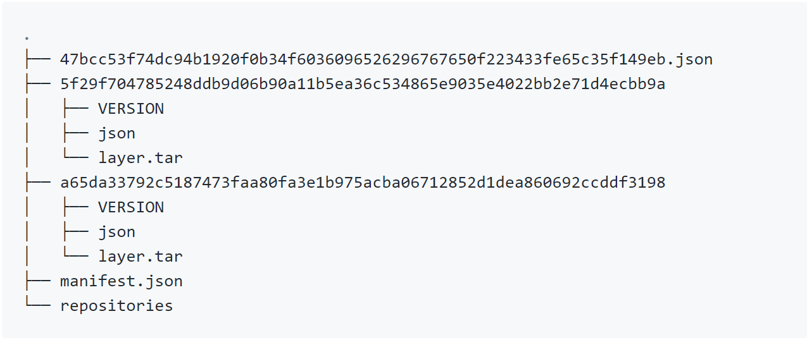
Container Image
An immutable, file-based template for a container that is created one of three ways:
Manual via a Docker commit
Automated with a Dockerfile
Pulled from a registry
Notes:
Reminder: what is an image?
Define container dependencies
Re-usable Read only layers
Based on file for local caching
In previous Docker image spec: Tree view with Image = metadata (json)+ layers (compressed tar payload)
Most recently Docker Image spec = one metadata (json) that contains all of the info about each layer. Tree view only necessary for backwards compatibility
Image creation:
Automated => Dockerfile
Manually => Docker commit
Can be re-used => from a registry

Slide 25
Image Layering
Base OS Image
Base OS Image
System Binaries
C:\Windows
Choices
Windows
Windows Server Core
Nano Server
Availability
Obtainable through Container Image provider
Published by Microsoft to the MCR
Directory “\Windows”
Host | \layer0\Windows
Directory “\Program Files”
Host | \layer0\Program Files
Notes:
You can choose your Base OS => which brings system DLL + Windows +Program Files
Next: Build on top of this

Slide 26
Image Layering
Base OS Image
IIS Image
Directory “\inetpub”
Host | \layer1\inetpub
Directory “\Windows”
Host | \layer0\Windows
Directory “\Program Files”
Host | \layer0\Program Files
Notes:
Or from a higher level, images can be imported
Start from an IIS based image => brings IIS specific dependencies
So you can build your component on top of IIS (good for lift and shift scenario)

Slide 27
Running Container
Base OS Image
IIS Image
Sandbox
Directory “\inetpub”
Host | \scratch\inetpub + index.html
Read-Only
Directory “\inetpub”
Host | \layer1\inetpub
Directory “\inetpub”
Host | \layer1\inetpub
Directory “\Windows”
Host | \layer0\Windows
Directory “\Windows”
Host | \layer0\Windows
Directory “\Program Files”
Host | \layer0\Program Files
Directory “\Program Files”
Host | \layer0\Program Files
Notes:
On top of IIS based image
Declare your IIS website => Only layer writeable

Slide 28



Dockerfile – Build IIS Server Container Image
Method for automated container image build
Consumed when running “docker build”
Enables automated builds via Docker Hub
Caches unchanged commands
microsoft/iis
Sandbox
Layer 1
FROM windowsservercore
RUN powershell –command
Add-WindowsFeature Web-Server
Container OS
Image
Notes:
2 options to build an IIS based image
Docker build from mcr iis image
OR Docker build from Windows base OS + RUN instructions to add the Web Sever Windows feature
Up to you but recommended to use the microsoft/iis.
Again: each layer is cached on the host (you don’t retrieve the base OS (X GB) every time you build the image).
Note: because it is based on Docker CLI and images are accessible from public Docker hub.
This process can be completely automated using scripting (CI/CD).

Slide 29
Demonstration: Building and Running IIS Server Container
Build IIS Container Image using Dockerfile
Run IIS Container
Notes:
Please refer to Module 2 – Demos document section Demo 2 for detail instructions about the demo.

Slide 30
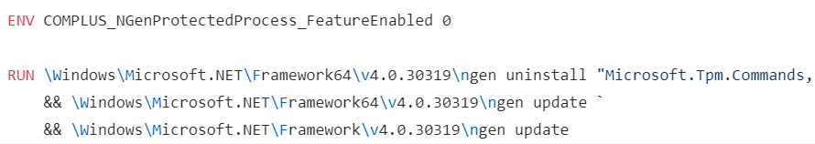

Dockerfile – Build ASP.NET 4.7 Container Image
Leverage Windows Server Core 2019 Container Image
Install .NET and ASP.NET 4.7
Copy MyWebApp to Container
MyWebApp
Sandbox
Layer 2
ASP.NET 4.7
Sandbox
Layer 1
Container OS
Image
Notes:
You can also Build your ASP.NET 4.7 application
2 choices:
From Base os: + Install the Framework => https://github.com/microsoft/dotnet-framework-docker/blob/master/4.7.2/runtime/windowsservercore-ltsc2019/Dockerfile
Then
Copy your website (binaries + HTML) into a particular folder => inetpub/wwwroot
OR
- From ASPNET base images => directly use mcr.microsoft.com/dotnet/framework/aspnet:4.7.2-windowsservercore-ltsc2019
The second option is recommended to benefit from Microsoft latest changes.
Rec

Slide 31
Demonstration: Package ASP.NET 4.7 Web Application as Container
Containerized ASP.NET 4.7 Web Application
Run ASP.NET 4.7 Web Application as Container
Notes:
Please refer to Module 2 – Demos document section Demo 3 for detail instructions about the demo.

Slide 32
Dockerfile – Build ASP.NET Core Container Image
Leverage IIS Container Image
FROM mcr.microsoft.com/dotnet/core/aspnet:2.2.3-nanoserver-1809
Copy ASP.NET Core App to Container
COPY published ./
Entrypoint set to Application
ENTRYPOINT ["dotnet", "mywebapp.dll"]
Layer 3
ASP.NET Core App
Sandbox
Layer 2
mcr.microsoft.com/aspnet
Sandbox
Layer 1
Nano Server
Image

Slide 33
Demonstration: Package ASP.NET Core Web Application as Container
Containerized ASP.NET Core Web Application
Run ASP.NET Core Application as Container
Notes:
Please refer to Module 2 – Demos document section Demo 4 for detail instructions about the demo.

Slide 34
Initiating an update of the Base OS Image
Rebuild containers using Dockerfile
Pull updated base image
My Website
IIS
10.0.14393.0
Notes:
2 ways of updating the OS in your container:
Rebuild your container from the new image
Run the update on top of your existing containers

Slide 35
Update Container OS Image
Pull updated base image
https://hub.docker.com/_/microsoft-windows-nanoserver
My Website
IIS
KB123456 = new image on Docker Hub
10.0.14393.0
10.0.14393.1
Notes:
First approach: - Download the updated image
From dot 0 to dot 1

Slide 36
Update Base OS Image
Create new image using Dockerfile
My Website
IIS
IIS
FROM windowsservercore
RUN powershell –command Add-WindowsFeature Web-Server
KB123456 = new image on Docker Hub
10.0.14393.0
10.0.14393.1
Notes:
Rebuild everything => Install IIS again

Slide 37
Update Base OS Image
Create new image using Dockerfile
My Website
My Website
FROM iis
ADD mysite.htm inetpub\mysite.htm
IIS
IIS
FROM windowsservercore
RUN powershell –command Add-WindowsFeature Web-Server
KB123456 = new image on Docker Hub
10.0.14393.0
10.0.14393.1
Notes:
Rebuild everything => install your website again
Up side:
You minimize the number of layers (lighter image)
Down side
- If your delta might be big so you don’t know which update broke your container.

Slide 38
Update as New Layer
Download update in container
When container is stopped update is applied as a new layer
Not a recommended practice
My Website
IIS
10.0.14393.0
Notes:
Other approach => add an update layer

Slide 39
Update as New Layer
Download update in container
When container is stopped update is applied as a new layer
Not a recommended practice
Layer 3
My Website
IIS
Same Image
10.0.14393.0
10.0.14393.0
Notes:
Dot 0 again

Slide 40
Update as New Layer
Download update in container
When container is stopped update is applied as a new layer
Not a recommended practice
Layer 3
My Website
My Website
Same Image
IIS
IIS
Same Image
Same Image
10.0.14393.0
10.0.14393.0
Notes:
Same iis image
Same website

Slide 41
Update as New Layer
Download update in container
When container is stopped update is applied as a new layer
Not a recommended practice
KB123456
My Website
My Website
Same Image
IIS
IIS
Same Image
Same Image
10.0.14393.0
10.0.14393.0
Notes:
Run Windows update on top
Upside:
- When you have multiple update, you know which one broke your container
- Better layer caching
Downside:
Longer to build
Bigger image size

Slide 42
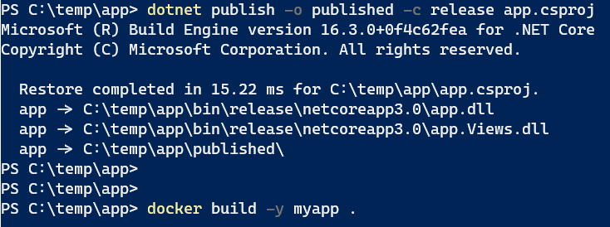
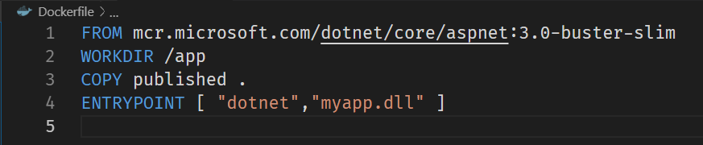
Pre-Multistage Dockerfile
Dockerfile.{purpose} to use for environments
Dockerfile: must compile application first
Notes:
A Dockerfile for dev which contained everything needed to build your application, was known as the “builder pattern”
When you run the build.sh script, it needs to build the first image, create a container from it to copy the artifact out, then build the second image.
Both images take up room on your system and you still have the app artifact on your local disk as well
https://docs.docker.com/engine/userguide/eng-image/multistage-build/
https://blog.alexellis.io/mutli-stage-docker-builds

Slide 43
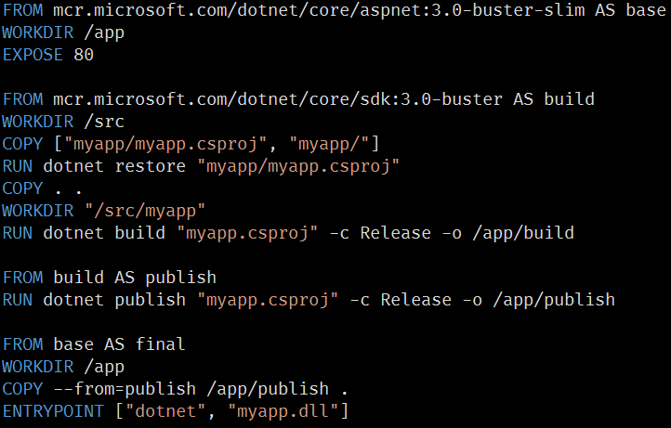
Multistage Dockerfile (Docker 17.5)
Use multiple FROM statements in your Dockerfile
Each FROM begins a new stage of the build and can use a different base image
Selectively copy artifacts from one stage to another
Notes:
A Dockerfile for dev which contained everything needed to build your application, was known as the “builder pattern”
You can use the COPY --from instruction to copy from a separate image, either using the local image name, a tag available locally or on a Docker registry, or a tag ID.
The Docker client pulls the image if necessary and copies the artifact from there.
https://docs.docker.com/engine/userguide/eng-image/multistage-build/
https://blog.alexellis.io/mutli-stage-docker-builds

Slide 44
Target a specific build stage
Debug a specific build stage
Use a debug stage with all debugging symbols or tools enabled, and a lean production stage
Use a testing stage in which your app gets populated with test data, but building for production using a different stage which uses real data
docker build --target build -t myrepo/myapp:latest
Notes:
https://docs.docker.com/engine/userguide/eng-image/multistage-build/
https://blog.alexellis.io/mutli-stage-docker-builds

Slide 45


Visual Studio Tools for Docker
Microsoft Visual Studio 2017 and 2019 provide integrated developer experiences for Docker
Leverage VS Code using the Docker extension
Layer 3
Notes:
VS tooling for Docker support
Integrated in the UI of the IDE
Both Windows and Linux based containers can be run/debbuged from the IDE (bottom right)
https://docs.microsoft.com/en-us/dotnet/core/docker/visual-studio-tools-for-docker

Slide 46
Demonstration: Visual Studio and Docker
Building ASP.NET Core Application using Visual Studio 2017/2019
Debugging ASP.NET Core Application using Visual Studio
Notes:
NOTE: At the time of writing behavior of Docker for Windows release require extra steps to configure and its integration with Visual Studio version 15.6.6 have some known issues. Considering that, make sure to try this demo ahead of time and only show to audience if everything is working as expected.
Please refer to Module 2 – Demos document section Demo 5 for detail instructions about the demo.

Slide 47
Group Managed Service Accounts for Windows containers
Although Windows containers cannot be domain joined, they can still use Active Directory domain identities to support various authentication scenarios
You can configure a Windows container to run with gMSA, which is a service account designed to allow multiple computers to share an identity without needing to know its password
Support for scheduling Windows containers with gMSAs in Kubernetes is available as an alpha feature in Kubernetes 1.14. See Configure gMSA for Windows pods and containers for the latest information about this feature and how to test it in your Kubernetes distribution
Notes:
EX USE CASE: When a service is running as Local System or Network Service in a container, it can use Windows Integrated Authentication to connect to a Microsoft SQL Server.
Windows-based networks commonly use Active Directory (AD) to facilitate authentication and authorization between users, computers, and other network resources. Enterprise application developers often design their apps to be AD-integrated and run on domain-joined servers to take advantage of Integrated Windows Authentication, which makes it easy for users and other services to automatically and transparently sign in to the application with their identities.
When you run a container with a gMSA, the container host retrieves the gMSA password from an Active Directory domain controller and gives it to the container instance. The container will use the gMSA credentials whenever its computer account (SYSTEM) needs to access network resources.

Slide 48

Lab: Getting Started with Containers
Duration : 60 Min
Module 2 : Getting Started with Windows Containers
Working with Nano Server/Win Sever Core
Build & Run IIS server on windows container
Build & Run ASP.Net 4.7 Application
Build & Run ASP.Net Core Application
Notes:
Complete by 50 min

